Slide 1
Conducting Virtual Interviews
HRA, Enterprise Talent Management Services
May 7, 2020

Slide 2
AGENDA
Best Practices
Shared Experiences
Kristen Matekenya | DOAS
Deana Brown | GDOT
https://youtu.be/UhjGQQpxFUc

Slide 3
BEST PRACTICE #1
Give the interviewee time to prepare
Although virtual is often associated with instant, give interviewee time to prepare
Is a virtual interview appropriate?
Is the Interviewee familiar with the platform to be used?

Slide 4
BEST PRACTICE #2
Develop questions and a standardized rating system
Questions should be relevant to the job being done
Same questions for all
Rating system standard and familiar to all interviewers

Slide 5
BEST PRACTICE #3
Choose a quiet and distraction-free location to conduct your interviews
Business like
Quiet and distraction free
Ensure privacy for candidate
Be more flexible with candidates. Not everyone has access to a separate business environment.

Slide 6
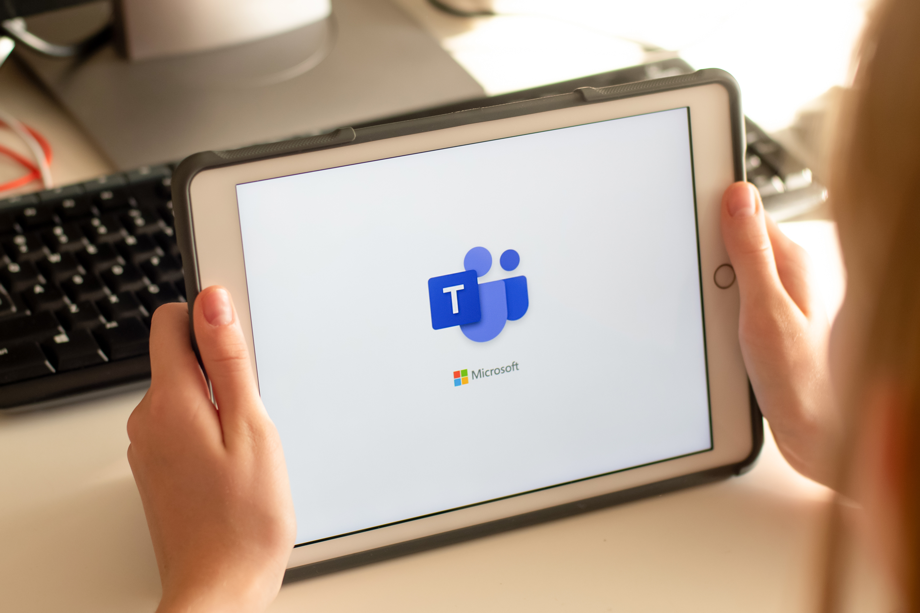
BEST PRACTICE #4
Identify the technology to be used and test your connection
Most are new to this format
Ensure the candidate is familiar
Start early to detect any problems before the start time

Slide 7
BEST PRACTICE #5
Dress Professionally
Know what your agency policy requires
Ensure all members of panel are aware of dress protocol
Advise candidate of expectations, including dress code

Slide 8
BEST PRACTICE #6
Conduct the virtual interview as you would an in-person interview
Ensure questions are job related and legal
Ask same questions of each candidate
Decide the order in which the questions will be asked before the interview if a panel is convened for the interview
Provide information on what the candidate can expect going forward

Slide 9
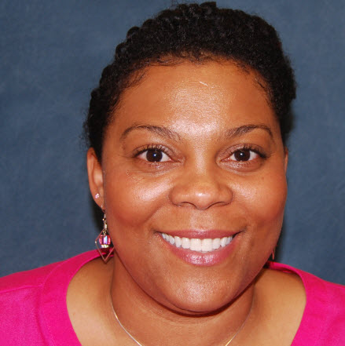
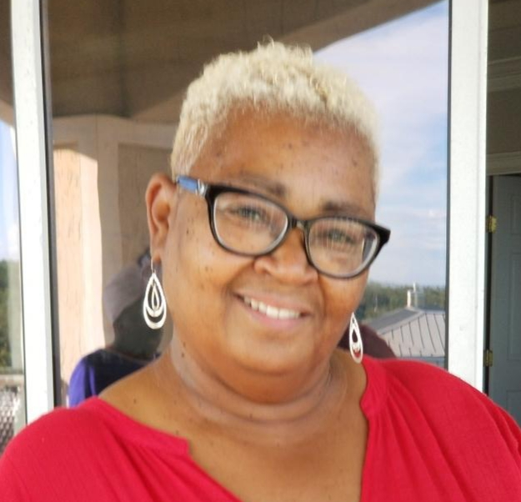
PEER EXPERIENCES
Kristen Matekenya
DOAS
eenya
DOAS
Deana Brown
GDOT

Slide 10
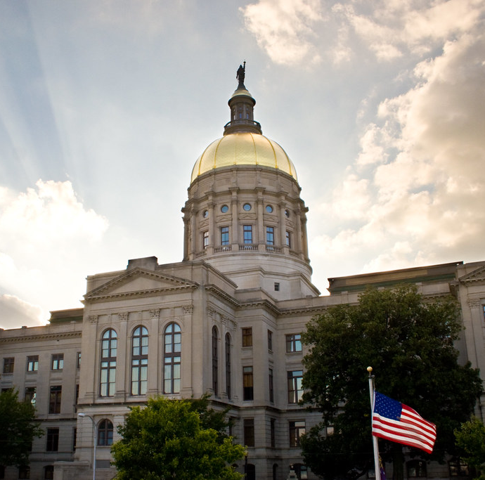
QUESTIONS
&
ANSWERS

Slide 11
CLOSING
Thank you for attending!
Human Resources Administration
www.hra.doas.ga.gov/contact

